Slide 1




Excelssior Education Society’s K. C. College of Engineering & Management Studies & Research (Affiliated to the University of Mumbai & Approved by AICTE) Mith Bunder Road, Near Hume Pipe, Kopri, Thane (E) – 400603 NAAC Accredited with B++ Grade
For the Degree of Third year of Computer Engineering
Academic Year 2024-25
ATMOSALERT
Shweta Shimpi (2022016402278264)
Ninad Walke (2022016402278063)
Aarya Walve (2022016402277953)
Guided by :
Prof Vedika Patil
( Assistant Professor )
Department of Computer Engineering
K. C. College of Engineering & Management Studies & Research, Thane (E)

Slide 2

OUTLINE OF PRESENTATION
Introduction
Literature Survey
Problem Statement
Aims & Objectives
DFD ,Usecase diagram (if applicable)
Methodology
Hardware & Software Specification
Result & Analysis
Conclusion
Acknowledgement
References

Slide 3
INTRODUCTION
What is AtmosAlert?
AtmosAlert is an innovative digital platform developed to help individuals safeguard themselves from sunstroke and other heat-related health risks in the face of rising global temperatures.
This system provides real-time weather-based health alerts, notifying users of extreme heat conditions that could lead to sunstroke.
It also includes an interactive symptom checker, allowing users to assess their symptoms and receive appropriate advice on whether they may be experiencing sunstroke or other heat-related illnesses.

Slide 4
PROBLEM STATEMENT
AtmosAlert addresses a set of critical challenges that individuals face in protecting themselves from sunstroke and other heat-related health issues, especially in the context of rising global temperatures. These challenges include the lack of timely health alerts, scattered safety information, poor symptom awareness, limited accessibility to personalized health advice, and inefficient tools for managing heat-related health risks.

Slide 5
OBJECTIVES
Centralization: Create a comprehensive platform that consolidates expert advice, safety tips, and preventative measures related to sunstroke and heat management in one accessible location for easy reference.
Provide Real-Time Health Alerts: Develop a system that delivers timely, location-based notifications about extreme weather conditions, particularly heatwaves, to help users take preventive measures against sunstroke and heat-related health risks.
Enhance Symptom Awareness: Implement an interactive symptom checker that educates users on the signs of sunstroke and other heat-related illnesses, providing actionable steps to take when symptoms arise.
Offer Personalized Health and Hydration Recommendations: Tailor safety tips, diet suggestions, and hydration plans to users based on their individual needs, including location, age, medical conditions, and activity levels during hot weather.

Slide 6
OBJECTIVES
Improve Accessibility and Usability: Ensure the platform is easily accessible across different devices, with a user-friendly interface that allows individuals to quickly access weather alerts, symptom checkers, and safety resources regardless of their technical ability or geographic location.
Encourage Proactive Health Management: Equip users with tools to monitor heat conditions and stay informed about potential health risks, encouraging them to take proactive measures to avoid sunstroke and manage heat exposure.
Continuously Update and Educate Users: Maintain an active blog and information hub that offers users the latest articles, expert advice, and updates on heatwave preparedness, sunstroke prevention, and general health management in hot weather.

Slide 7
PROPOSED METHODOLOGY
Research and Requirements Gathering:
Conduct surveys, interviews and focus group to identify user needs.
Analyze existing solutions to identify gaps and opportunities.
Design Phase:
Create wireframes and prototypes for each section of the website, focusing on user-friendly interfaces and easy navigation.
Define the overall architecture of the website, including the technologies to be used.
Development:
Develop the frontend using React.js ensuring responsiveness across different devices.
Manage the backend using Node,js and use a robust database system, MongoDB.
Integrate third-party libraries or frameworks as needed for enhanced functionality.

Slide 8
PROPOSED METHODOLOGY
4. Testing and Quality Assurance:
Conduct thorough testing of each website feature to ensure functionality, usability, and compatibility across different browsers and devices.
Perform user acceptance testing (UAT) with a sample group of users to gather feedback and identify any issues or areas for improvement.
5. Deployment:
Deploy the website to a hosting environment, ensuring scalability and reliability.
6. Maintenance and Updates:
Regularly monitor website performance and user feedback to identify bugs or areas for improvement.
Plan regular updates and feature enhancements based on user input.

Slide 9
LITERATURE SURVEY
Website / Research Paper Name | Unique Features | Target Audience | Monetization Strategy
Heat Illness Prevention (CDC) | Comprehensive sunstroke prevention tips, emergency response guidance, symptoms checklist | General public, outdoor workers, athletes | Government-funded, no direct monetization
Heat Stress in the Workplace (NIOSH) | Focuses on heat stress among workers, with practical advice and safety guidelines | Occupational workers, employers, safety officers | Funded by public health agencies, no direct monetization
Weather.com | Weather forecasts, personalized alerts based on entered city, heat index calculation | General public, outdoor enthusiasts, commuters | Ad-supported, affiliate partnerships with weather-related products
MedlinePlus: Heat Illness | Easy-to-understand symptoms and treatment guidance, trusted medical information | General public, healthcare professionals | Government-funded, no ads or direct monetization
WebMD: Heatstroke Guide | Symptom checker, causes and prevention tips, integrated with personalized health tools | Individuals concerned with health conditions, general public | Ad-supported, affiliate links to health-related products and services

Slide 10
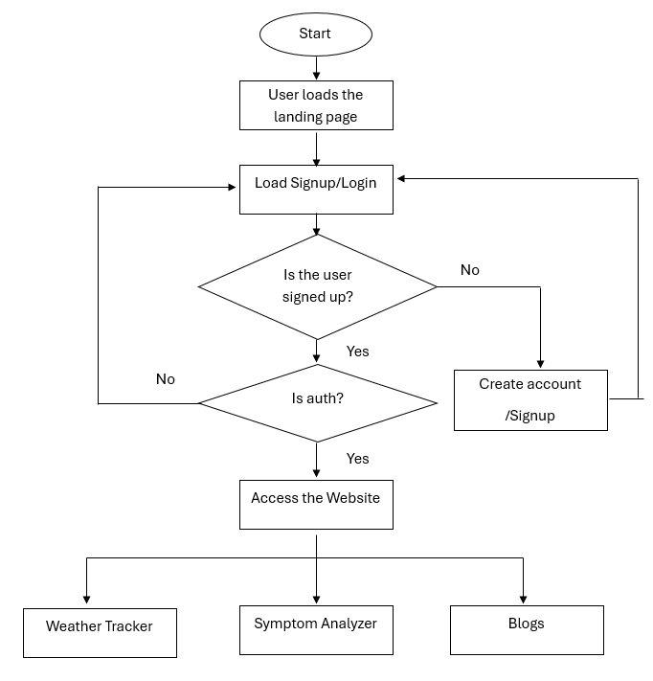
DIAGRAM

Slide 11
HARDWARE AND SOFTWARE SPECIFICATIONS
Hardware Requirements:
1. Components:
Processor: At least dual-core processor (recommended quad-core or higher for better performance)
RAM: Minimum 1GB (recommended 4GB or more for better performance)
Storage: At most 5 GB of storage to download required resources and set up a browser.
2. Networking:
Stable internet connection with sufficient bandwidth to handle user traffic.
3. Backup System:
Regular backup solution to prevent data loss in case of hardware failure or other issues.

Slide 12
HARDWARE AND SOFTWARE SPECIFICATIONS
Software Requirements:
Operating System:
Windows server(Recommended).
Alternatively, Linux (e.g., Ubuntu Server, CentOS) or Unix-like system (preferred for stability and security) can be used if preferred or required.
Web Server:
Chrome/Firefox/MS Edge for serving web pages.

Slide 13
Thank You!!
Any Questions??
IOT Based Smart Energy Meter

